Slide 1
Beyond Manual Tags: Enhancing User Experience with AI-Powered Item Classification
Applied Machine Learning
Cedric KOH Bo Xiang
GAN Seng Zhan
GOH Yun Si
HUANG Mochen
WU Junqi

Slide 2
Agenda
01
02
03
04
05
Business Problem, Solutions & Pipeline
Business Background, Technical Solutions, Project Pipeline
Data Source, EDA and Processing
Data from Kaggle and online scraping
EDA, Processing
Modelling
RF, KNN, XGBoost, CNN
Conclusion
Evaluation
Limitations and Future Work
Limitations, Prospects

Slide 3
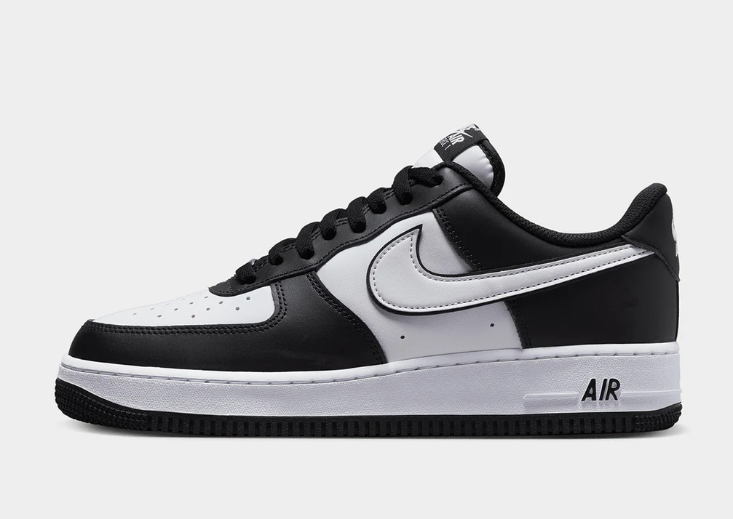


Business Statement & Technical Solutions
Business Problem
Technical Solutions
SautyFash, the popular second-hand sneaks trading platform
Two Recurring Feedbacks
Tricky Posting Flow
Irrelevant Items Recommended
Image Classification
Image Processing
Machine Learning
Data Augmentation
HOG Feature Extraction
CNN Feature Extraction
Modelling
Random Forest
KNN
XGBoost
Deep Learning
CNN
ResNet50
Nike Dunk
Nike Air Force 1 Low

Slide 4
Pipeline
To explore how classical models performs on sneaker classification with extracted features, and compare its results with deep learning models (CNN).
Sneakers Images
Image Processing
Manual Data Augmentation
CNN-Auto Data Processing and Augmentation
HOG Feature Extraction + PCA
CNN Feature Extraction
CNN
KNN
XGB
RF
KNN
XGB
RF

Slide 5
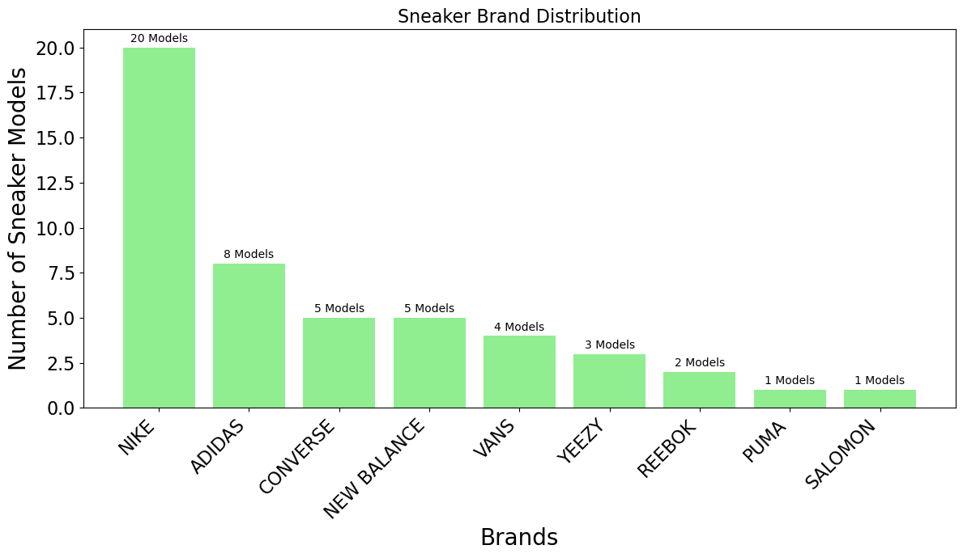
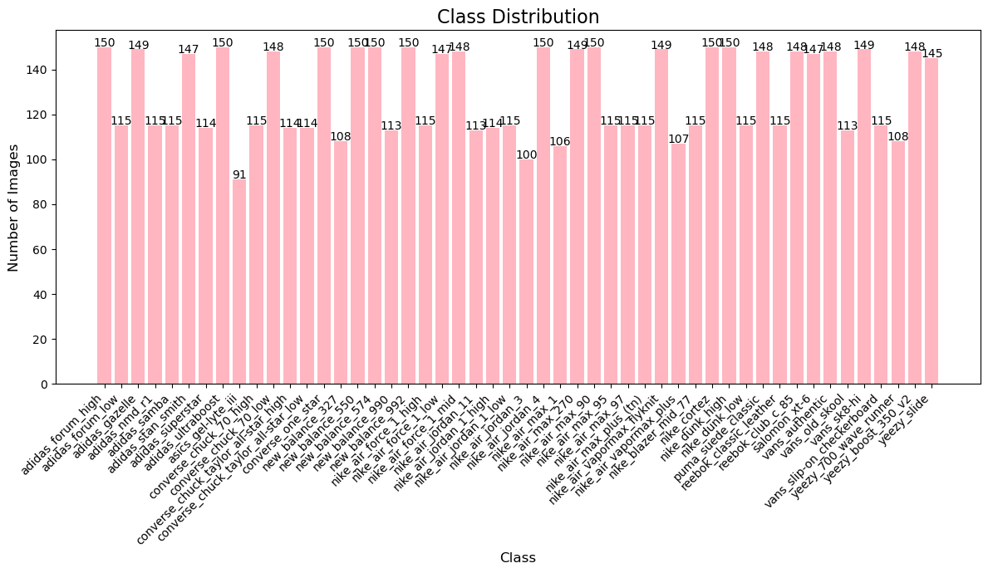
Data Briefing
Main Data Set
Popular Sneakers Classification Dataset: https://www.kaggle.com/datasets/nikolasgegenava/sneakers-classification
Supplementary Data Set
Scrapping Online (batch scraping with IP rotation & random delays)
Brands Summary
Sneaker Summary
Brands:
Popular Brands: Nike, Adidas, New Balance, Vans, Salomon, Yeezy …
50 Popular Sneaker Models: Air Force 1, Dunk, Air Jordan 1
Image Classes:
Max #Samples: 150
Min #Samples: 91
Mean #Samples: 130
Median #Samples: 115

Slide 6
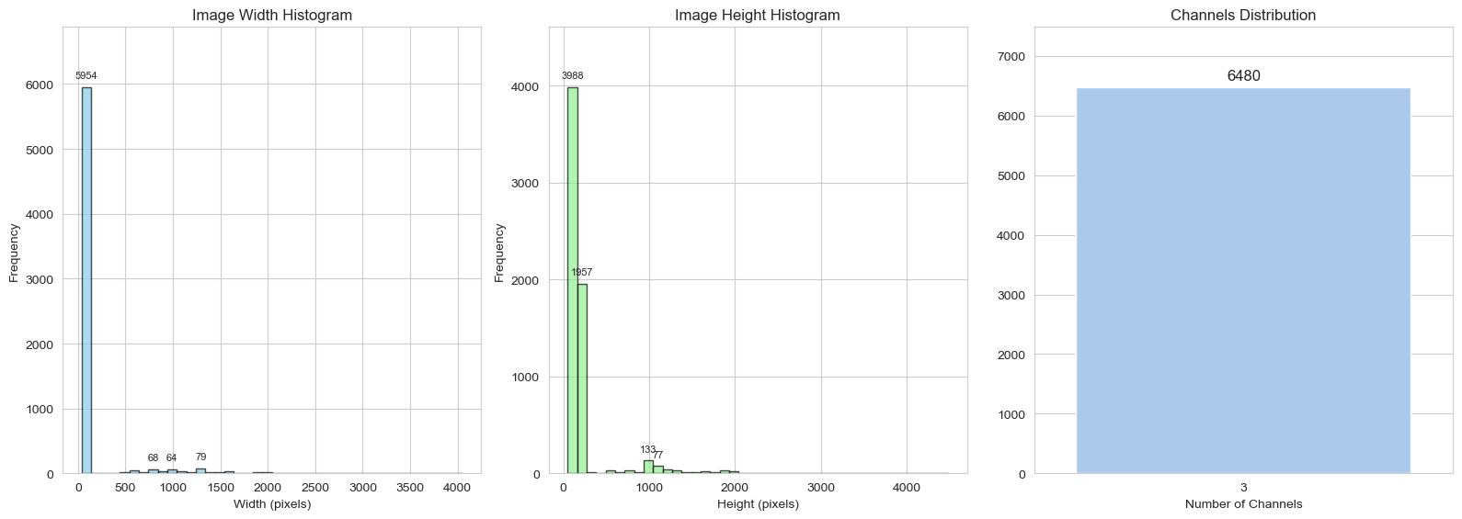
Exploratory Data Analysis, EDA: Image Attribute Analysis
Summary
Checked image dimensions
Width and height distributions
Most images within 120–140 pixels height.
Decided to resize to 224×224 for consistency.
Verified all images are RGB, 3 channels per image
Width X Height X Channel

Slide 7
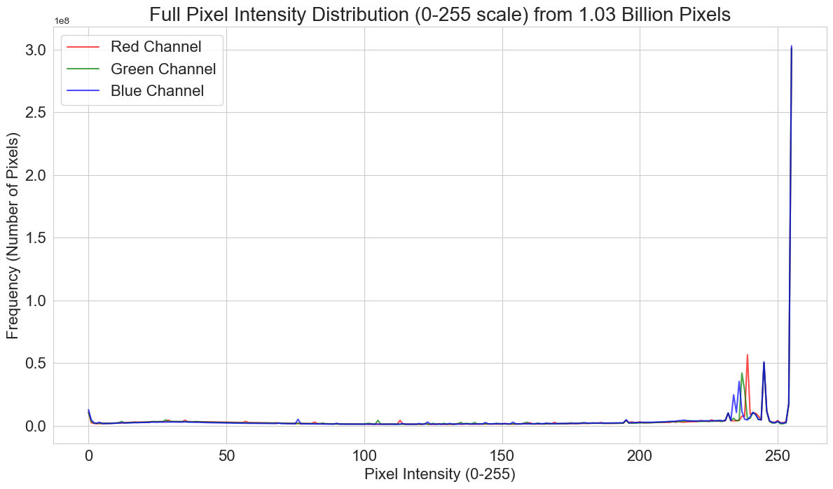
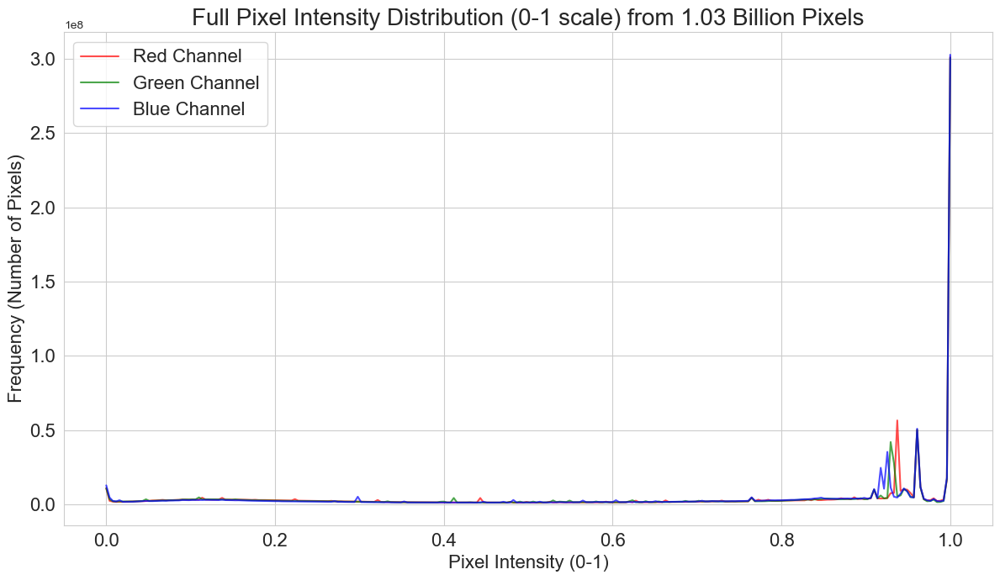
Exploratory Data Analysis, EDA: Pixel Analysis
Analysed pixel intensity distribution across all images
Observed high concentration near maximum brightness
One peak: very bright
Confirmed consistent RGB channel behavior
Summary
Full Pixel Intensity
Normalised Pixel Intensity

Slide 8
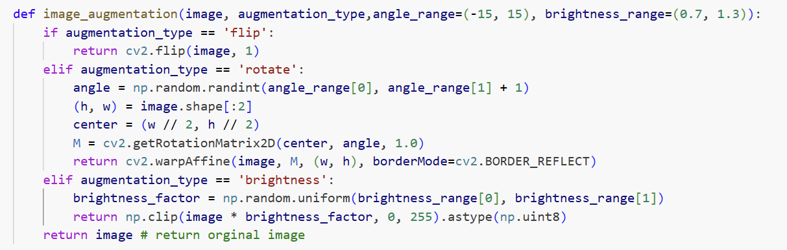
Image Processing
Original Images
Resized Images (224, 224)
CNN Automatic Image Processing Pipeline
Input X for CNN
ResNet 50 Feature Extractor
Gray Scaled Images
Horizontally Flipping
Data Augmentation
Randomly Rotated
(-15, +15)
Weights & Bias Frozen
HOG Feature Extraction
Brightness Adjusted
(0.7, 1.3)
Feature Extraction
PCA Dimensionality Reduction
Input X for Non-CNN Models
Input X for Non-CNN Models

Slide 9
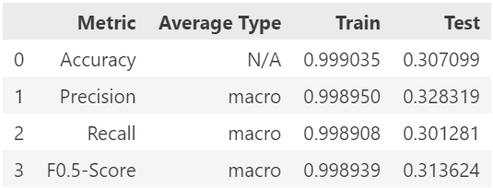
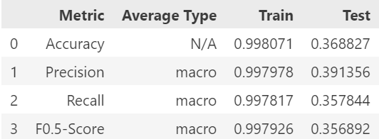
Modelling: Random Forest
Reasoning to use this model: A traditional identification method used before the advent of deep learning, it stands out for its ability to handle high-dimensional data, its robustness against overfitting, and its efficiency through parallelism.
Risks of using this model:
Replying on manually feature extraction which has limited feature representation capability
Computationally intensive and memory-hungry when dealing with large datasets or features
May still overfit in high-dimensional and non-diverse data
HOG Feature Extraction
CNN Feature Extraction
Randomized Search Hyperparameter Tuning (cv=3, n_iter=10):
n_estimators (50 to 200): more trees generalizes better but slower
max_depth (10 to 40): larger depth fit better but may overfit
max_features (sqrt, log2, 0.5 to 1.0): lower values uses smaller fraction of features, reducing overfitting by adding randomness
HOG VS CNN Extraction
Both not satisfying
CNN Extraction Slightly Better

Slide 10
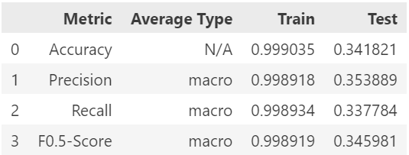
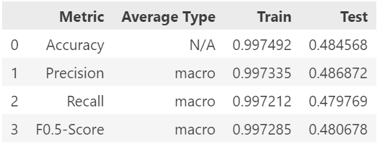
Modelling: XGBoost
Reasoning to use this model:
Robustness to Overfitting
Flexibility and Hyperparameter Tuning
Handles Imbalanced Data
Risks of using this model:
Heavily relies on hyperparameter tuning and prone to overfitting if not properly tuned
Sensitive to noise
High computation cost
Randomized Search Hyperparameter Tuning (cv=3, n_iter=10):
n_estimators (50 to 500): more trees fit better but may overfit
max_depth (3 to 12): larger depth fit better but may overfit (especially with boosting)
learning_rate (0.01 to 0.2): lower rate generalizes better but slower and requires more trees
subsample (0.7 to 1.0): lower values uses smaller fraction of training data, reducing overfitting by adding randomness
colsample_bytree (0.7 to 1.0): lower values uses smaller fraction of features, reducing overfitting by adding randomness
HOG Feature Extraction
CNN Feature Extraction
HOG VS CNN Extraction
Both not satisfying
CNN Feature Extraction Much better

Slide 11
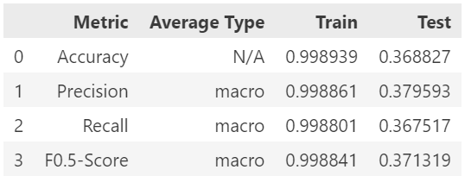
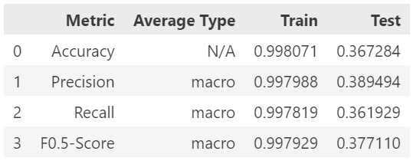
Modelling: K-Nearest Neighbour Classifier
Reasoning to use this model:
“Lazy Learner”: Simplicity and Interpretability
Risks of using this model:
Long inference time and computationally and memory expensive for large datasets
Sensitive to noise, class imbalance, and curse of dimensionality
Manual feature extraction needed, it cannot automatically learn hierarchical, robust, and abstract features directly from raw image pixels.
HOG Feature Extraction
Randomized Search Hyperparameter Tuning (cv=3, n_iter=10):
n_neighbors (1 to 30): smaller captures local pattern, larger generalizes better
weights (uniform, distance): equal weights, or higher weights for closer neighbours
metric (euclidean, manhattan, cosine): cosine calculates angles between vectors (expected to be better for image)
CNN Feature Extraction
HOG VS CNN Extraction
Both not satisfying
The performances for Two methods are similar

Slide 12
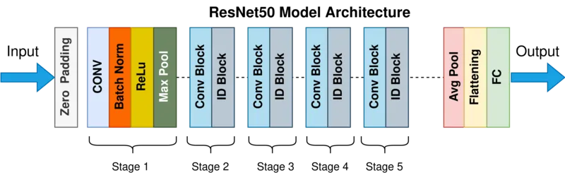
Modelling: CNN – ResNet50
Model Utilized: Residual Networks 50 Model (ResNet50) (50 layers)
Reasoning to use pre-trained model - trained on larger dataset so model should be able to identify features better
Model commonly used for many computer vision tasks ^{[1]}
Avoid Vanishing Gradient Problem → by Residual Connection ^{[2]}
Methodology:
Initialise DataLoader for Train, Validation and Test Data
Data transformation done differently for Training and Validation/Test dataset
Initialise and freeze weights for all layers of pretrained model
Replace the Fully Connected Layer → Transfer Learning
Epoch training and Tuning by validation
Model Evaluation using test data
Evaluation Metrics
Dataset | Accuracy | Precision (Macro) | Recall (Macro) | F-0.5-Score (Macro)
Training | 0.9843 | 0.9843 | 0.9842 | 0.9841
Validation | 0.8194 | 0.8335 | 0.8183 | 0.8247
Testing | 0.7901 | 0.8087 | 0.7859 | 0.7969
Source: (1) https://blog.devgenius.io/resnet50-6b42934db431, (2) https://medium.com/@nitishkundu1993/exploring-resnet50-an-in-depth-look-at-the-model-architecture-and-code-implementation-d8d8fa67e46f

Slide 13
Evaluations
Model | Training Time (Minutes) | Accuracy |  | Precision |  | Recall |  | F0.5
 |  | Train | Test | Train | Test | Train | Test | Train | Test
HOG_KNN | 0.0 | 0.9989 | 0.3688 | 0.9989 | 0.3796 | 0.9988 | 0.3675 | 0.9988 | 0.3713
HOG_XGB | 48.2 | 0.9990 | 0.3418 | 0.9989 | 0.3539 | 0.9989 | 0.3378 | 0.9989 | 0.3460
HOG_RF | 26.8 | 0.9990 | 0.3071 | 0.9990 | 0.3283 | 0.9989 | 0.3013 | 0.9989 | 0.3136
CNN_KNN | 0.2 | 0.9981 | 0.3673 | 0.9980 | 0.3895 | 0.9978 | 0.3619 | 0.9979 | 0.3771
CNN_XGB | 216.4 | 0.9975 | 0.4846 | 0.9973 | 0.4869 | 0.9972 | 0.4798 | 0.9973 | 0.4807
CNN_RF | 49.2 | 0.9981 | 0.3688 | 0.9980 | 0.3914 | 0.9978 | 0.3578 | 0.9979 | 0.3569
Model | Training Time (Minutes) | Accuracy |  |  | Precision |  |  | Recall |  |  | F0.5
 |  | Train | Valid | Test | Train | Valid | Test | Train | Valid | Test | Train | Valid | Test
CNN | 10.5 | 0.9843 | 0.8194 | 0.7901 | 0.9843 | 0.8335 | 0.8087 | 0.9842 | 0.8183 | 0.7859 | 0.9841 | 0.8247 | 0.7969

Slide 14
Conclusions
1
For Feature Extraction:
CNN Feature Extraction > HOG Feature Extraction
2
For Overall Model Performance
Convolutional NN > XGBoost > Random Forest > K-Nearest Neighbour

Slide 15
Limitations & Future Work
Limitations
Limited sneaker model coverage: the current model is limited to specific sneaker brands and models included in the dataset, which may lead to the model may not accurately classify new or niche sneakers
Limited data augmentation: the current data augmentation should be included more operations, and when introducing more operations, the order between gray scaled and data augmentation should be changed.
Sensitive to image capture angles: the model may not function correctly if users take photos from angles that deviate from the requirements, which restricts the flexibility and may lead to classification inaccuracies or failures.
Limited training resources: due to the large number of training data and limited computing resources, hyperparameter tuning was not very comprehensive.
Overfitting Problem: The performance gap between training and testing is around 20%, indicating that the model is overfitted.
Future Work
Enlarge the datasets to improve accuracy by continuous data collection and diversified data sources
Train the models on more types and more angles of sneakers to improve the generalisability
Apply more data augmentation techniques and adjust the order of the pipeline
Add new capabilities to models such as check authenticity of shoes, resale price prediction
Future versions can integrate with Large Language Models (e.g. GPT)

